Slide 1
Customs clearance of low-value commercial postal consignments
The Customs National Board
01.07.2026.

Slide 2

Goods not eligible for simplified declaration
Simplified declaration is not available for:
  excise goods;
  goods subject to prohibitions or restrictions.
    The purchase of tobacco products, electronic cigarettes and refill containers from online stores and their receipt in postal consignments is prohibited!
Where simplified declaration is not permitted, a standard import customs declaration must be lodged, requiring more extensive customs expertise.

Slide 3
Simplified declaration of goods
If the goods contained in a consignment received from a third country with a value not exceeding EUR 150 are eligible for simplified declaration, an Import Customs Declaration for Postal Consignments must be completed and submitted in the State Revenue Service Electronic Declaration System (EDS).

Slide 4
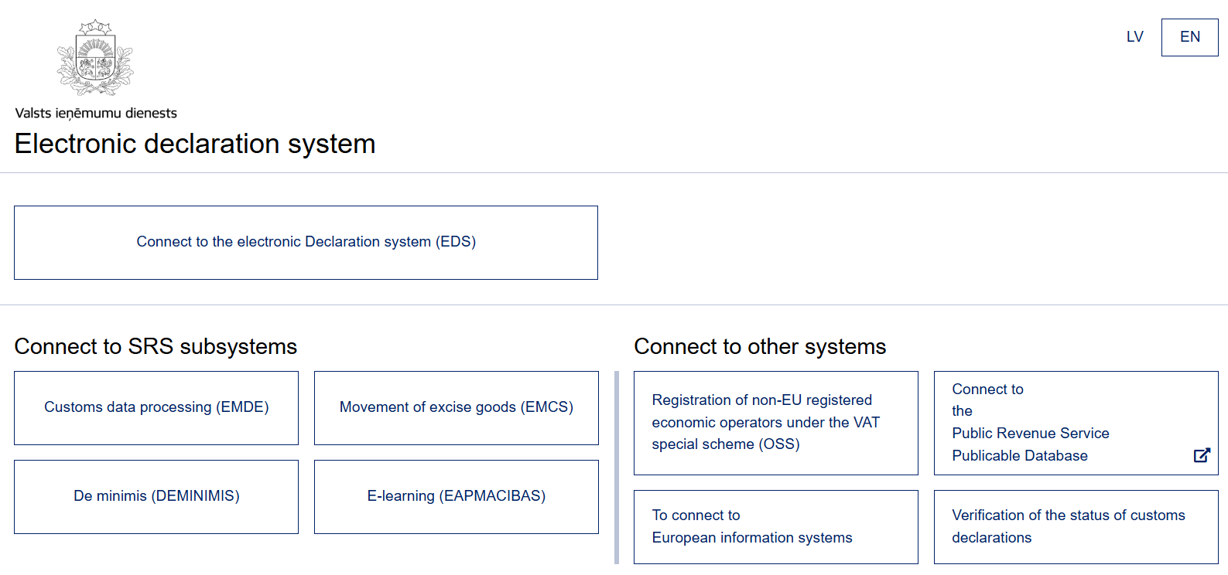
How to log in to the declaration system?
Taxpayers from other countries, may log in using an EDS username, that can be acquired by completing an application.

Slide 5
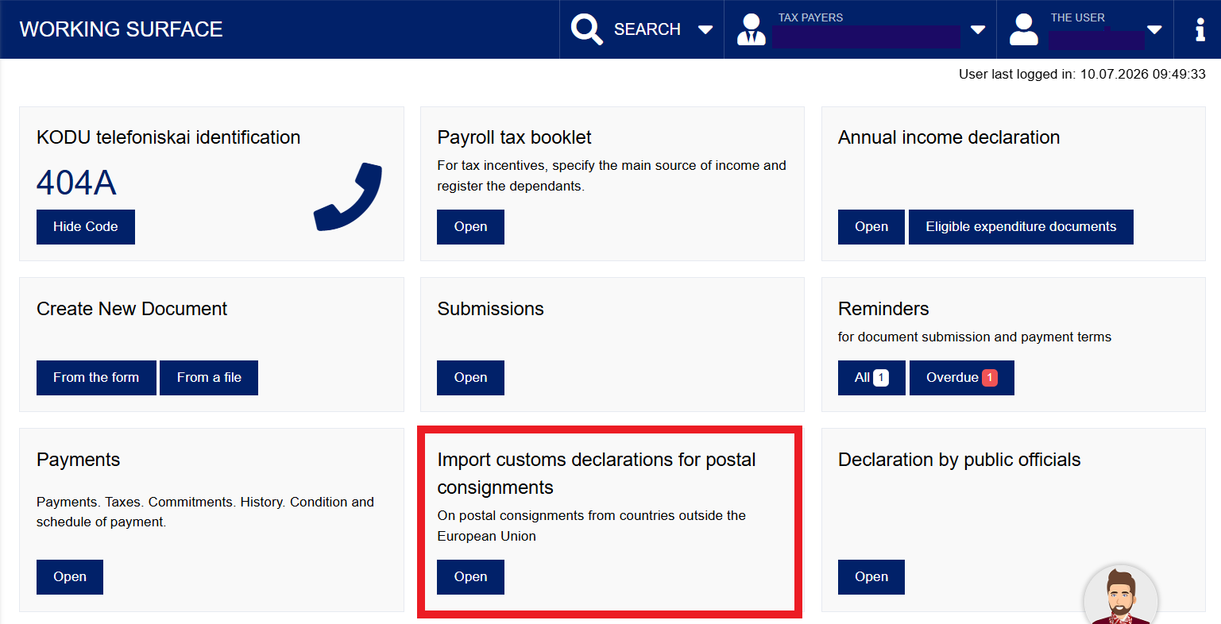
Select Import customs declarations for postal consignments and click the Open button.

Slide 6
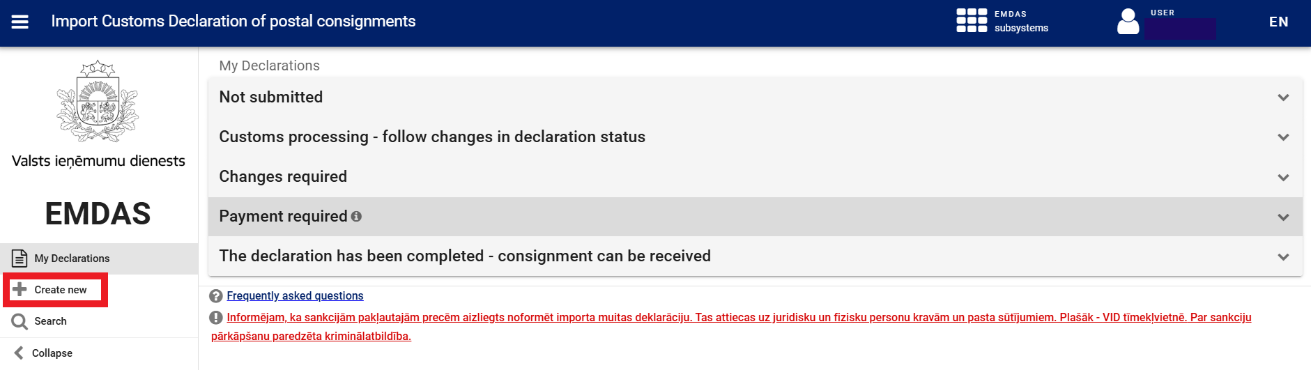
Import Customs Declaration of postal consignements
The statuses of previously created customs declarations are displayed.
To lodge a new declaration, select “Create new”.

Slide 7
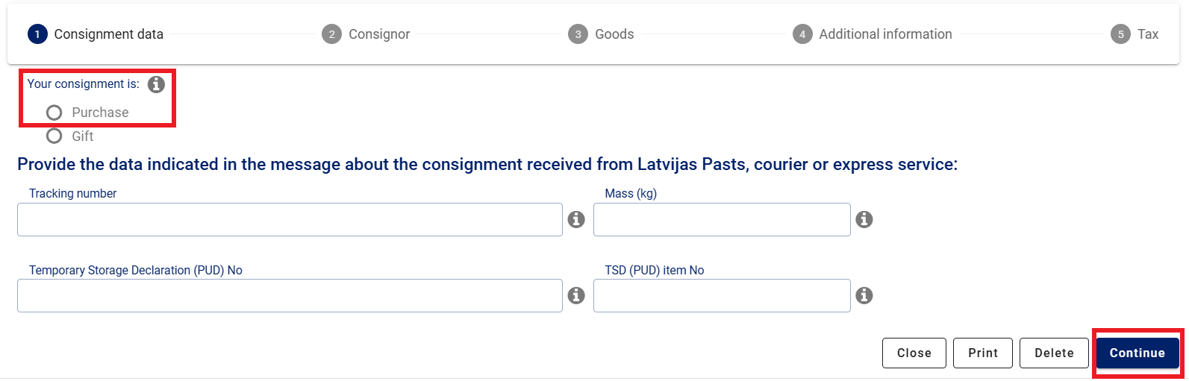
Consignment data
Step 1:
The postal operator or courier service places the consignment in its warehouse – a temporary storage facility, assigning a temporary storage declaration number (TSD number/PUD) and an item sequence number.
The information can be found in the notification received from the postal operator to clear the consignment through customs (via SMS, e-mail or a printed notification).

Slide 8
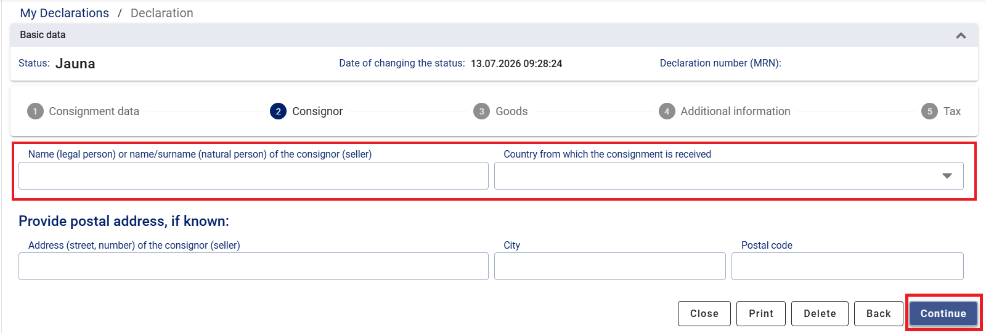
Consignor
Step 2:
The sender’s name must be indicated – eBay, iHerb, AliExpress, Temu, etc.
The country from which the consignment was received must also be indicated, for example, China (CN), the United States (US), the United Kingdom (GB).

Slide 9
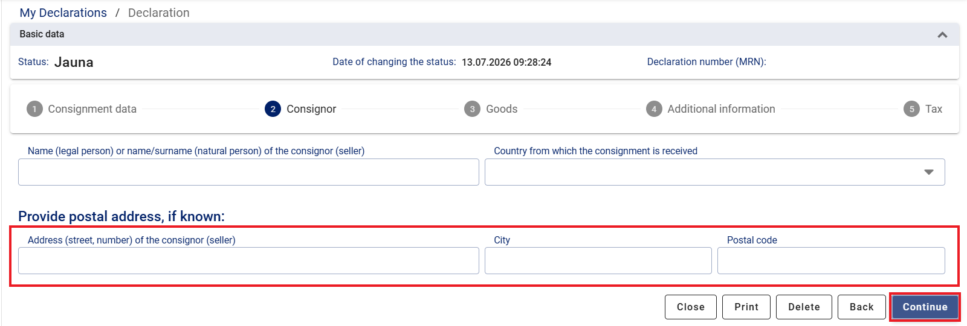
Consignor
Step 2:
This information is not mandatory and should only be completed if available.

Slide 10
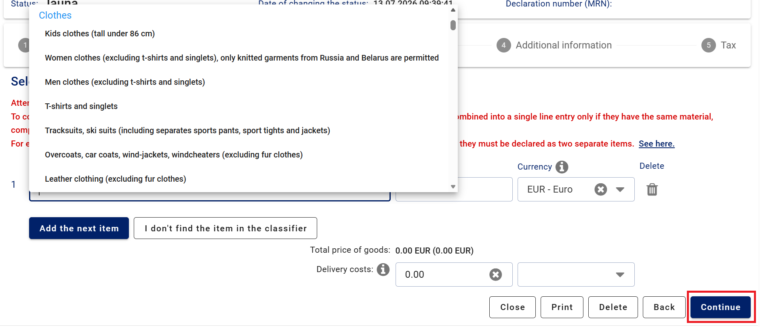
Goods
Step 3:
1
2
3

Slide 11
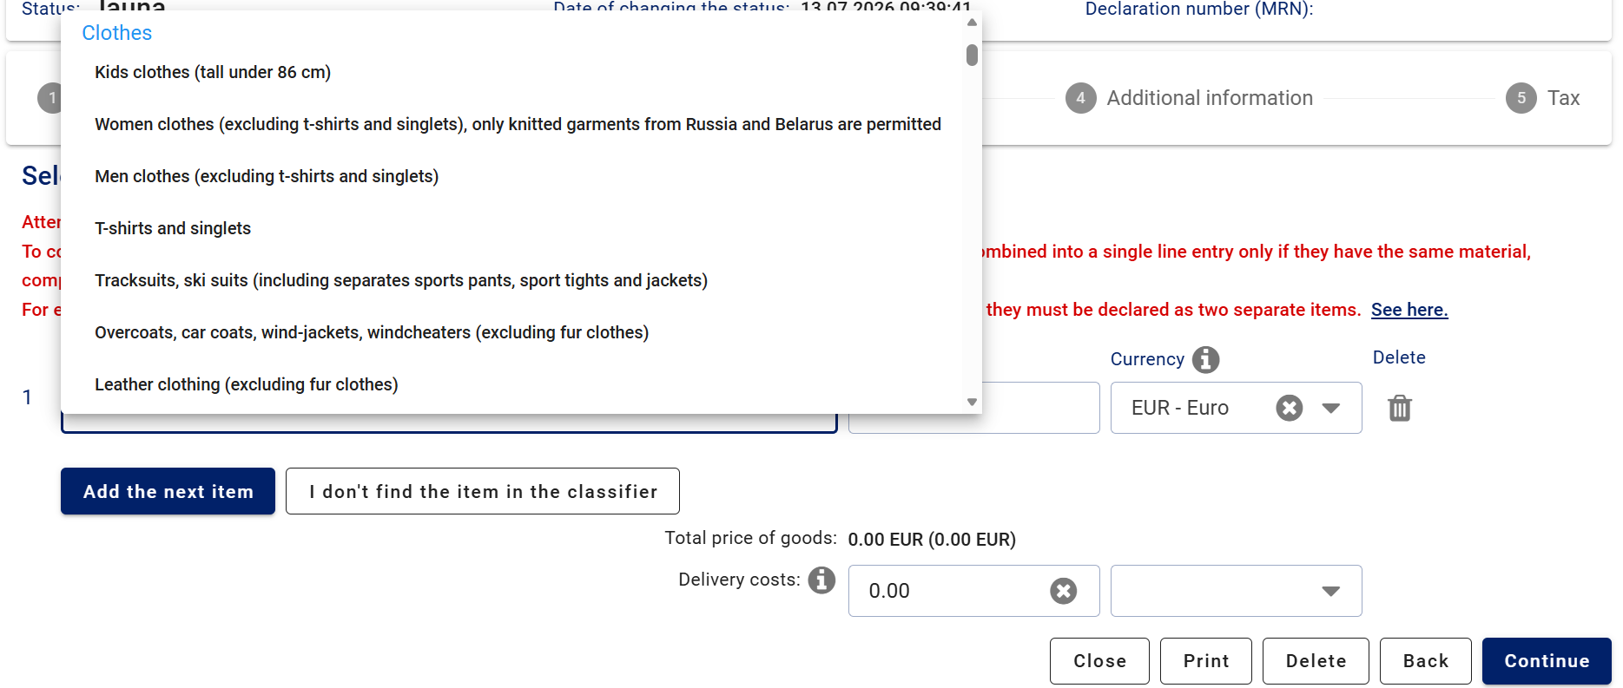
Goods – Goods classifier
3. solis:
The item must be selected from the classifier, where goods are grouped into categories.
If the item is not listed in the classifier, it is subject to a restriction or prohibition and cannot be declared using the simplified declaration procedure.
If the item is not listed in the classifier, you will be redirected to complete a standard customs declaration. Before selecting “Continue”, please make sure once again that the item is indeed not listed in the classifier.

Slide 12
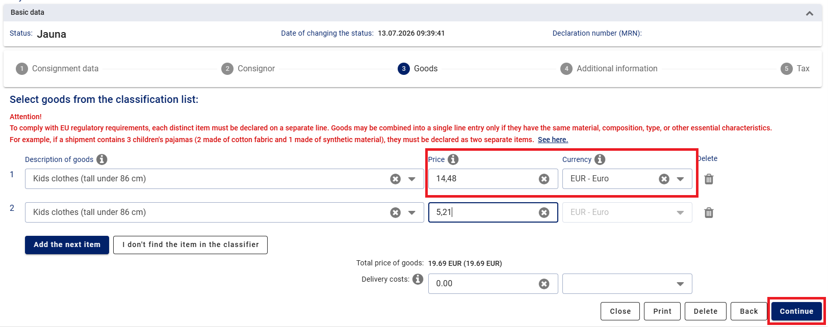
Goods - Price
Step 3:
The purchase price and currency for the specific item, as stated on the invoice, must be indicated.

Slide 13
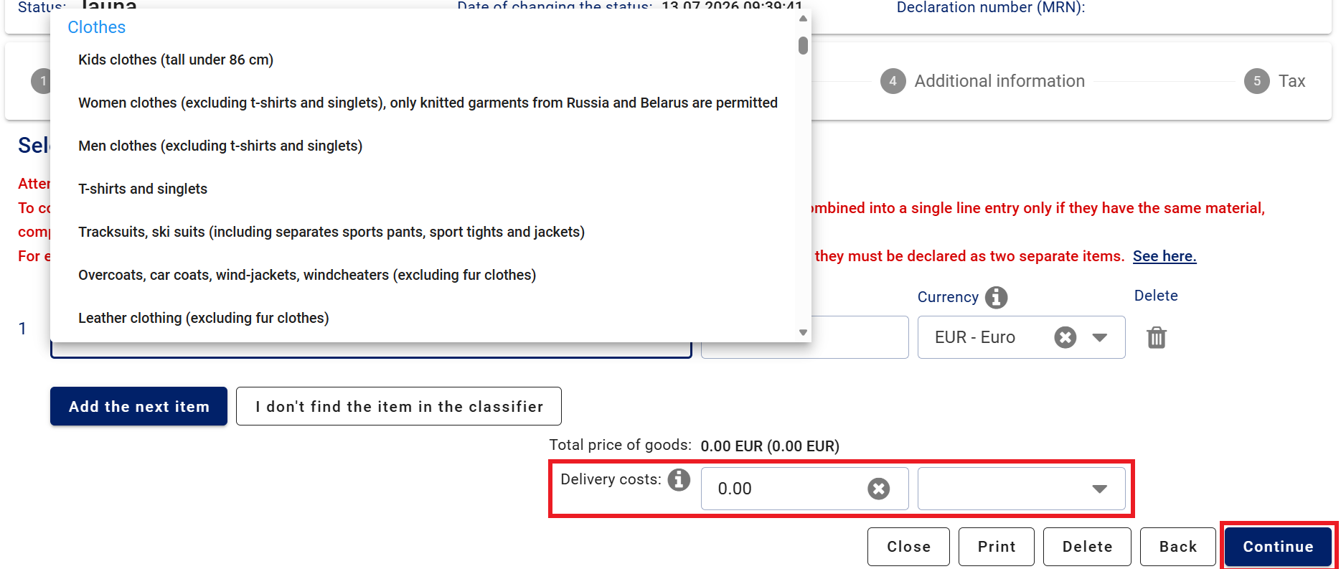
Goods – Delivery costs
Step 3:
The shipping costs must be indicated if they are not included in the price of the goods.

Slide 14
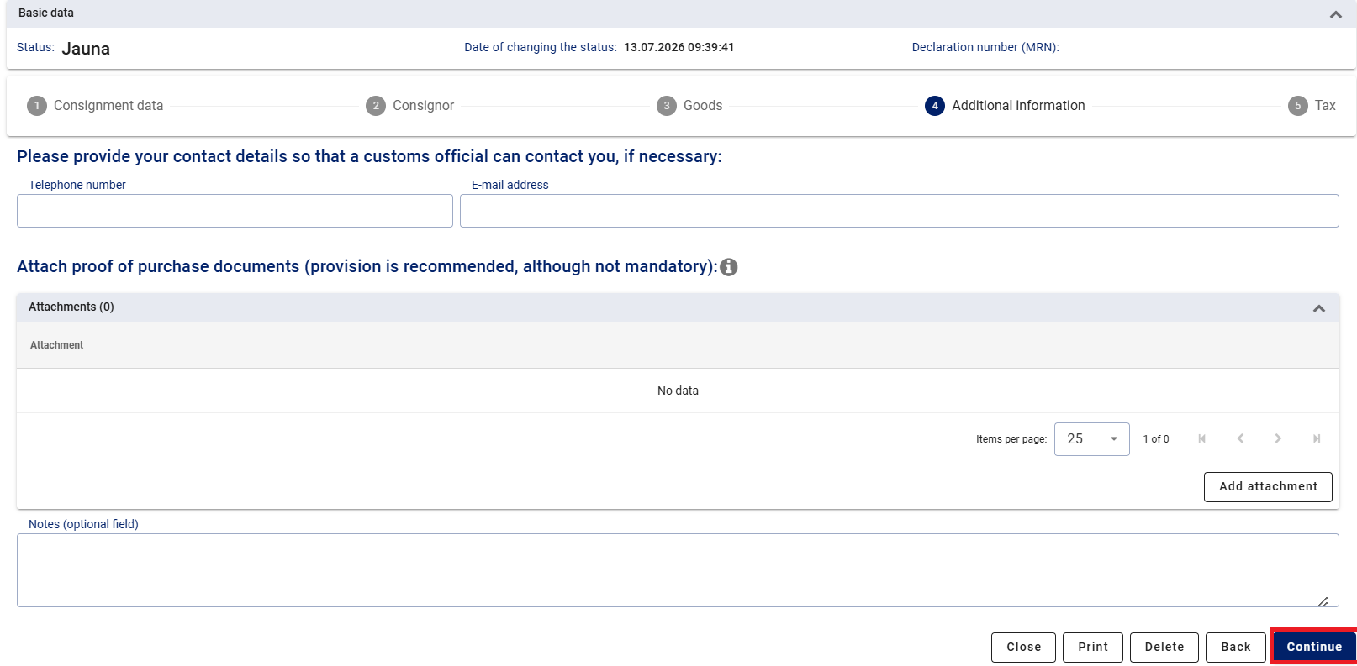
Additional information
Step 4:
It is recommended to provide your contact details so that a customs officer can contact you if necessary.
Attachments should only be submitted upon request by a customs officer.

Slide 15
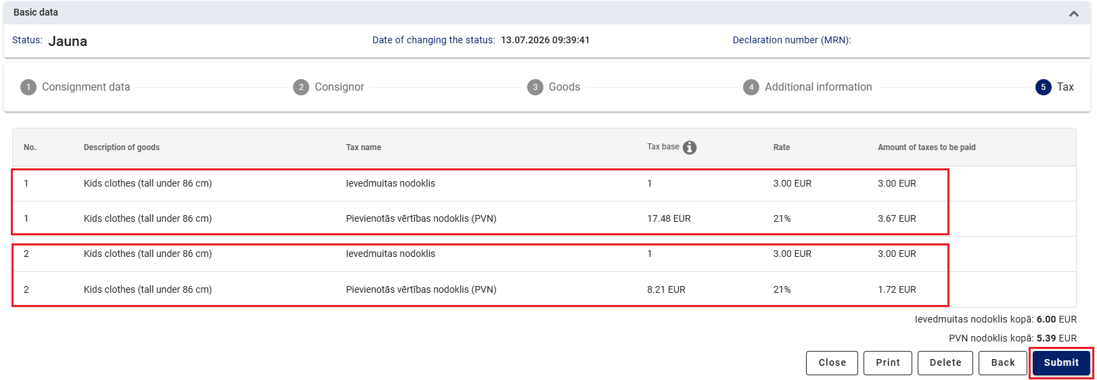
Taxes and submission of the declaration
Step 5:
The tax calculation is displayed according to the declared items.

Slide 16
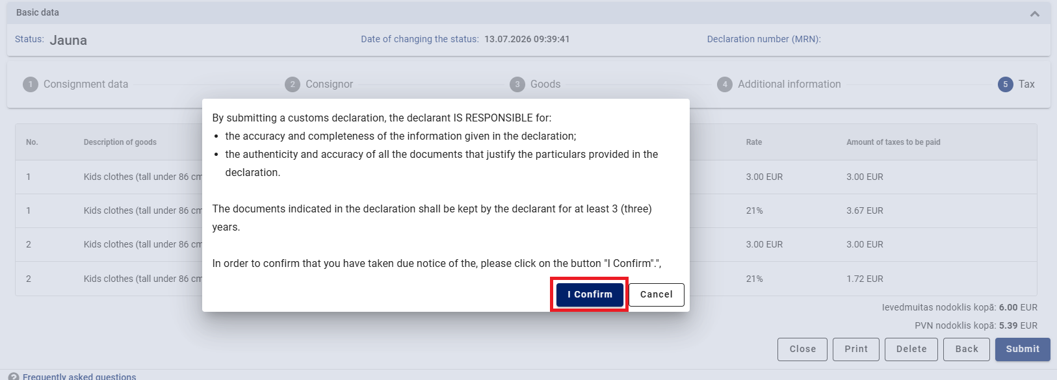
Taxes and submission of the declaration
Step 5:

Slide 17
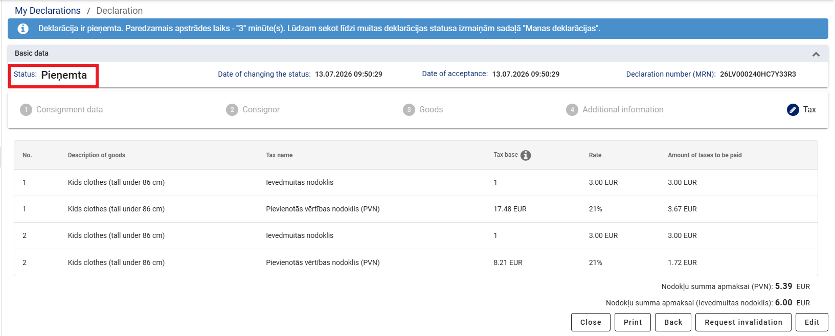
Deklarācijas apstrāde
6. solis:
After a certain period of time, the declaration status changes from “Accepted”(Pieņemta) to “Payment required”. If the declaration has the status “Under control”, additional information or amendments may be requested. Once the control process has been completed, the status changes to “Payment required”.

Slide 18
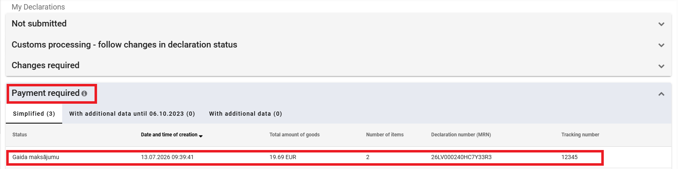

Step 7:
Payment of taxes
Once the submitted customs declaration has been processed, its status changes to “Payment required”.
To pay the taxes, open the relevant declaration by clicking on the corresponding row, then select the “Pay” button.

Slide 19
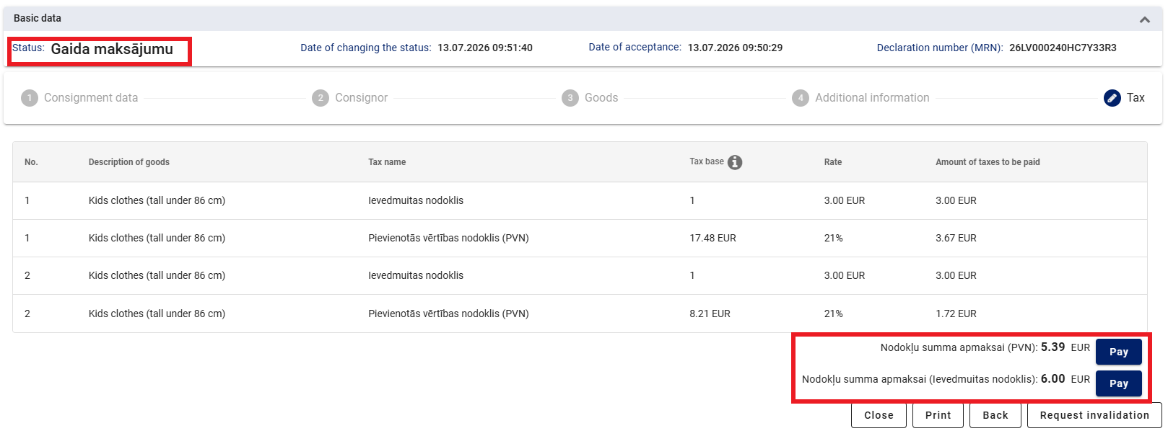
Payment of taxes
Step 7:
Status: Payment required
Amount of taxes to be paid (VAT): 5.39 EUR
Amount of taxes to be paid (import duty): 6.00 EUR

Slide 20

Why pay directly from the declaration in EDS?
Step 7:
If the payment is not made through EDS but instead via internet banking, you will need to wait until the bank transfers the funds to the State Treasury budget account, which may take several days.
Notes:
Nevajag nekādus MK noteikumu minēt

Slide 21
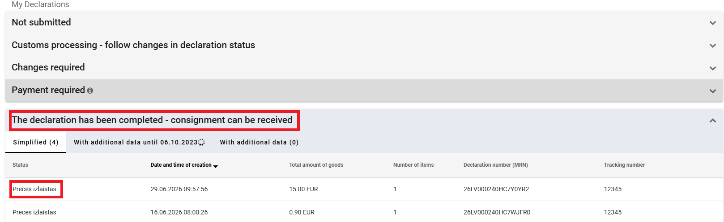
Receiving the consignement
Step 8:
After making the payment, you must wait until the status of the declaration is “Goods released”(Preces izlaistas).
Afterwards, you will receive information from JSC “Latvijas Pasts” or the express mail service regarding the receipt of the consignment at the post office or parcel locker.

Slide 22
